Slide 1

LOGISTICS WAREHOUSE SHIPPING AND STOCK PERFORMANCE REVIEW Q1-Q2 2023
Fachmi Maris

Slide 2

Objectives
Able to analyze, process data and visualize data
Able to analyze data based on statistics

Slide 3
DATASET
status | Shipping, prcessing, complete, retruned ,and cancelled
Created_at | the time or date on which the order or transaction was made or processed.
Shipping_at | refers to the time or date when the order or goods were sent by the seller or the sender.
Delivery_at | refers to the time or date when the order or goods were successfully sent and received by the customer
Retruned_at | refers to the time or date when the customer returns the item they ordered. This indicates when the item is returned to the warehouse or store after the customer has requested a return
Preparation duration | (Shipping_at) – (Created_at)
Delivery duration | (Delivery_at) – (Shipping_at)

Slide 4
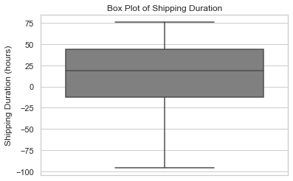
Exploratory Data Analysis
> Found `12294` rows of data with ambiguous values or nearly `20%`of the number of rows in the dataset

Slide 5
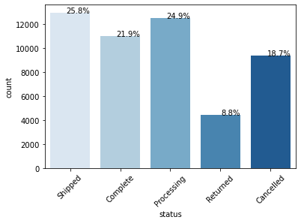
Exploratory Data Analysis
Comparison of the percentage of the contents of the status column
Found a Return of 8.8% in the overall dataset which can make the company lose

Slide 6
Exploratory Data Analysis
use the describe function to find out simple statistics
Shipping Duration
count | 28367
mean | 1 days 11:00:15.237705784
std | 0 days 20:55:30.953452976
min | 0 days 00:00:04
25% | 0 days 16:55:32
50% | 1 days 09:37:50
75% | 2 days 04:40:21
max | 3 days 03:47:05
Deliery Duration
count | 15408
mean | 2 days 11:42:23.348909657
std | 1 days 10:31:49.178354605
min | 0 days 00:00:00
25% | 1 days 05:54:00
50% | 2 days 11:10:00
75% | 3 days 17:10:00
max | 4 days 23:59:00
`The average time it takes a customer to receive the goods from the initial order is 3 days 22 hours or almost 4 days`

Slide 7
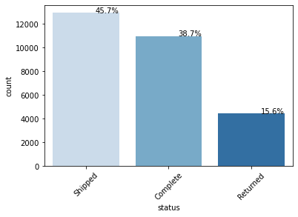
Exploratory Data Analysis
Visualize the percentage of the `status` column that has been filtered at least `shipped_at` input
The percentage of Returned at 15.6% is quite concerning because returns above 5% are already dangerous

Slide 8
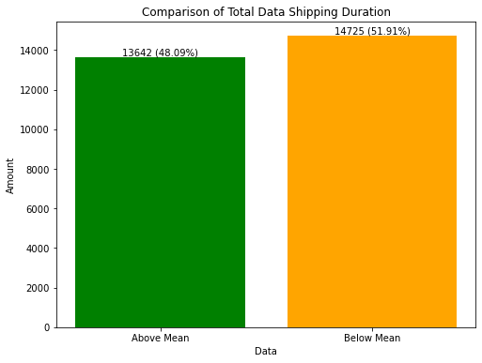
Exploratory Data Analysis
visualization of the comparison of `preparation_duration` bove the mean and below the mean
If the mean preparation duration is used as the lead time for executing 1 order, then the performance condition is very bad

Slide 9

KPI
Quantity (Shipping + Complete)
100%
84.38%
Key Performance Index
Quantity (Shipping + Complete+Returned)

Slide 10

Conclusion
The `Shipping_duration` feature has data irregularities of 20% of the total data. Input may not be according to the procedure
Returned status of `15.6%` must be evaluated and followed up because it makes the company lose
48.9% data duration preparation is longer than the mean preparation duration
Mean Shipping Duration : 1 day 11 hours
Mean Delivery Duration : 2 days 11 hours
Mean Customer Receives Orders: `3 days 22 hours almost 4 days`
The system from Created_at to Delivery_at must be evaluated in determining the delivery lead time for customer orders
KPI Shipping Performance Review overall `84.38%`

Slide 11

THANKS
Do you have any questions?
Fachmi.maris@gmail.com

